Slide 1
Mini Presentation 2
7 August 2020

Slide 2
Covid-19 Impact on Singapore Banking Sector
What will be the impact on the customer loans and customer deposits , the bread and butter of Banks, during the current Covid-19 crisis ?
Banking sector has weathered through 2 financial crisis namely, Asian Financial Crisis (1997-1998) and Global Financial Crisis (2007-2008).
Will the impact of the current Covid-19 crisis be similar to that of the previous 2 crisis ?

Slide 3
Source of Data
Public Data Set - Monetary Authority of Singapore (“MAS”) API
API for Table I.10 Banks: External Assets and Liabilities of DBUs, Monthly
API for Table I.10A Banks: External Assets and Liabilities of DBUs and ACUs, Monthly
Fields of API (next slide)

Slide 4
API Documentation for Table I.10A
No | Name | Title | Type | Unit Of Measure | Description
1 | end_of_month | End of month | Datetime (Month) "YYYY-MM"
2 | preliminary | Preliminary indicator | Numeric (General) |  | '1' if preliminary, '0' otherwise.
3 | assets_total | Assets - Total | Numeric (General) | S$ Million
4 | assets_foreign_notes_coins | Assets - Foreign Notes and Coins | Numeric (General) | S$ Million
5 | assets_adfb | Assets - Amounts due from Banks | Numeric (General) | S$ Million | Note: Includes Asian Currency Units.
6 | assets_lnbc | Assets - Loans and Advances to Non-Bank Customers | Numeric (General) | S$ Million
7 | assets_bills | Assets - Bills Discounted or Purchased | Numeric (General) | S$ Million | Note: Prior to June 1999, data on bills financing include bills refinanced by the Monetary Authority of Singapore.
8 | assets_sae | Assets - Securities and Equities | Numeric (General) | S$ Million
9 | assets_other_foreign | Assets - Other Foreign Assets | Numeric (General) | S$ Million
10 | liab_total | Liabilities - Total | Numeric (General) | S$ Million | Note: The methodology for computing foreign liabilities has been revised for data from March 2004, to be consistent with the treatment of data relating to Singapore's external sector.
11 | liab_dnbc | Liabilities - Deposits of Non-Bank Customers | Numeric (General) | S$ Million
12 | liab_adtb | Liabilities - Amounts due to Banks | Numeric (General) | S$ Million | Note: Includes Asian Currency Units.
13 | liab_bills | Liabilities - Bills Payable | Numeric (General) | S$ Million
14 | liab_other_foreign | Liabilities - Other Foreign Liabilities | Numeric (General) | S$ Million
15 | net_foreign_assets_liab | Net Foreign Assets / Liabilities (-) | Numeric (General) | S$ Million

Slide 5
API Documentation for Table I.10
No | Name | Title | Type | Unit Of Measure | Description
1 | end_of_month | End of month | Datetime (Month) "YYYY-MM"
2 | preliminary | Preliminary indicator | Numeric (General) |  | '1' if preliminary, '0' otherwise.
3 | assets_total | Assets - Total | Numeric (General) | S$ Million
4 | assets_foreign_notes_coins | Assets - Foreign Notes and Coins | Numeric (General) | S$ Million
5 | assets_adfb | Assets - Amounts due from Banks | Numeric (General) | S$ Million
6 | assets_lnbc | Assets - Loans and Advances to Non-Bank Customers | Numeric (General) | S$ Million
7 | assets_bills | Assets - Bills Discounted or Purchased | Numeric (General) | S$ Million
8 | assets_sae | Assets - Securities and Equities | Numeric (General) | S$ Million
9 | assets_other_foreign | Assets - Other Foreign Assets | Numeric (General) | S$ Million
10 | liab_total | Liabilities - Total | Numeric (General) | S$ Million
11 | liab_dnbc | Liabilities - Deposits of Non-Bank Customers | Numeric (General) | S$ Million
12 | liab_adtb | Liabilities - Amounts due to Banks | Numeric (General) | S$ Million
13 | liab_bills | Liabilities - Bills Payable | Numeric (General) | S$ Million
14 | liab_other_foreign | Liabilities - Other Foreign Liabilities | Numeric (General) | S$ Million
15 | net_foreign_assets_liab | Net Foreign Assets / Liabilities (-) | Numeric (General) | S$ Million

Slide 6
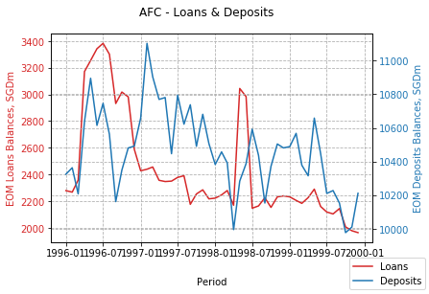
1997 Asian Financial Crisis
The Asian financial crisis was a period of financial crisis that gripped much of East Asia and Southeast Asia beginning in July 1997 and raised fears of a worldwide economic meltdown due to financial contagion.
Source: Wikipedia
Deposits balances declined in 1997 and started to increase in late 1998
Loans balances declined from 1997 onwards
Only DBU balances

Slide 7
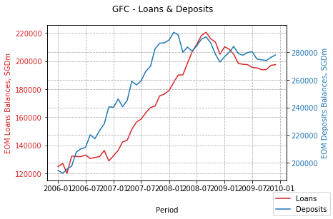
2007–08 Global Financial Crisis
The financial crisis of 2007–2008, also known as the global financial crisis, was a severe worldwide financial crisis. Excessive risk-taking by banks combined with the bursting of the United States housing bubble caused the values of securities tied to U.S. real estate to plummet, damaging financial institutions globally, culminating with the bankruptcy of Lehman Brothers on September 15, 2008 and an international banking crisis. The crisis sparked the Great Recession, a global recession, which, at the time, was the most severe recession since the Great Depression. It was also followed by the European debt crisis, which began with a deficit in Greece in late 2009, and the 2008–2011 Icelandic financial crisis.
Source: Wikipedia
Deposits balances increased through the GFC
Loans balances increased through the GFC
Seem to be Capital Flight to Singapore

Slide 8
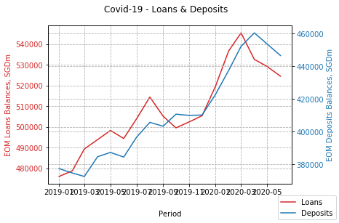
Covid-19 2020
The COVID-19 pandemic, also known as the coronavirus pandemic, is an ongoing global pandemic of coronavirus disease 2019, caused by severe acute respiratory syndrome coronavirus 2. The outbreak was first identified in Wuhan, China, in December 2019. The World Health Organization declared the outbreak a Public Health Emergency of International Concern on 30 January 2020, and a pandemic on 11 March. As of 22 June 2020, more than 8.91 million cases of COVID-19 have been reported in more than 188 countries and territories, resulting in more than 466,000 deaths; more than 4.4 million people have recovered.
Source: Wikipedia
Deposits balances started to decline on 2020-06
Loans balances started to decline on 2020-04
Will both balances decline further, similar to AFC ? Will there be capital flight to Singapore similar to GFC ?

Slide 9
Appendix - Requirements
Create a mini-project based on any skills from the course so far:
select an interesting public data set (from APIs) or form a question you are interested answer and identify data needed to answer the question
use Jupyter Notebook to access, analyse and visualise the data
Prepare a 5-minute presentation
use Jupyter Notebook
organise as:
question
dataset
conclusion
plan to present to the class

